Slide 1

Color Guessing Game Using Python Library Tkinter
A project by:
Syeda anshrah gillani
MIRZA SAMAD

Slide 2

TKINTER ?
Tkinter is widely used for developing GUI applications. Along with applications, we can also use Tkinter GUI to develop games.

Slide 3
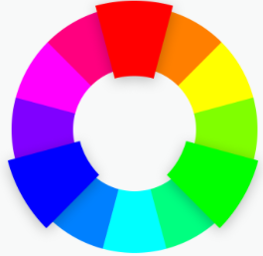
What is Color Guessing Game?
In this game a color name appears having a different color then it’s name.
For example:
The player has to enter the color of the word that appears on the screen.
Hence the score increases by one.
The total time to play this game is 30 seconds.
Pink
Here the correct answer
will be ‘green’ not pink
Enter here

Slide 4

Getting Started With Coding
We’ll be using python idle for coding

Slide 5

1. Importing Modules
For opening &
manipulating images
To print data in nicely
formatted tables

Slide 6

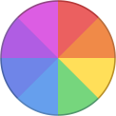
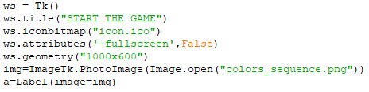
2. Getting Started With GUI development
icon.ico
Colors_sequence.png

Slide 7
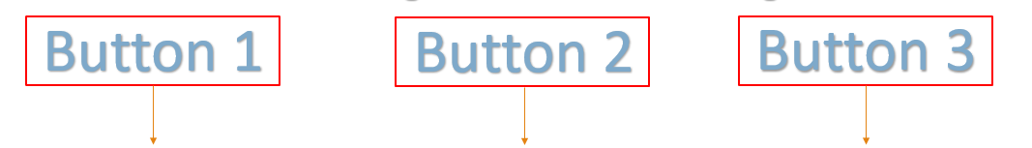
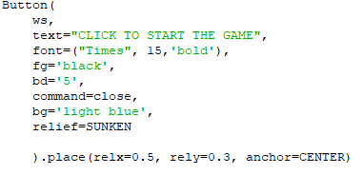
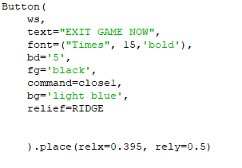
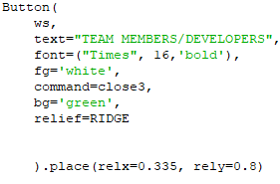
3. Creating Buttons
We’ll be creating three buttons
Button 1
Button 2
Button 3
def close()
def close3()
def close1()

Slide 8
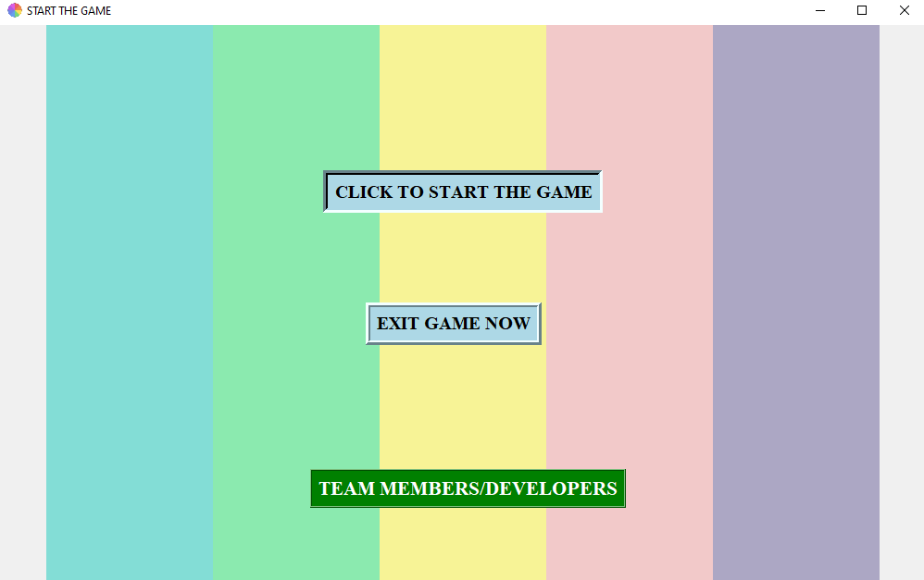
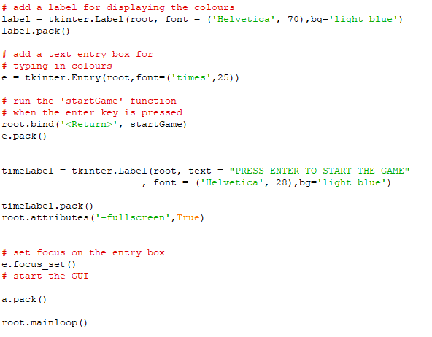
This is what our GUI will look like after creating the buttons.

Slide 9






The following functions would be called behind each button as shown.
Which will result in
importing the file COLORS2
saved in the same location
Which will result in
importing the file COLORS4
saved in the same location
Which will result in
destroying the GUI

Slide 10
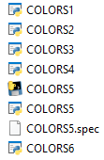

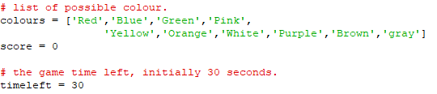
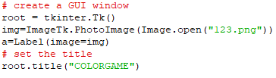
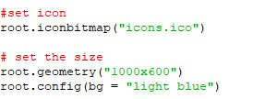
File COLORS2
Slide 1
This is a python file that will be executed
Behind the button 1 ( Click to Start the Game)
Creating &manipulating
new GUI

Slide 11
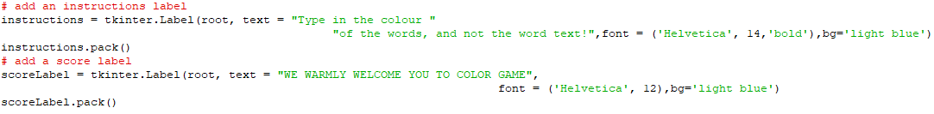
File COLORS2
Slide 2
Calling function StartGame
as soon as the enter key is pressed

Slide 12
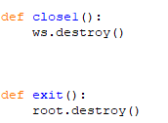
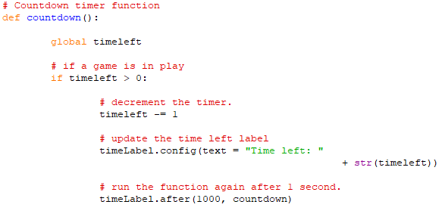
Functions created in the file
Slide 1
Functions for destroying
the GUI’s
Function for updating the
countdown label

Slide 13
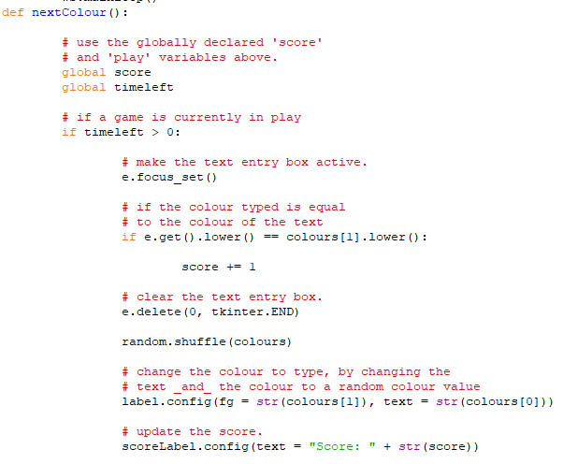
Functions created in the file
Slide 2
For displaying the colors
randomly, updating the score &
clearing the entry box
when required

Slide 14
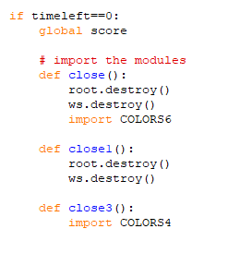
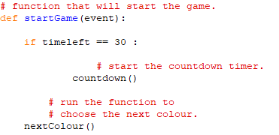
The Function startGame
Slide 3
This is the main Function in which the previously created functions are called.
Importing
respective files

Slide 15
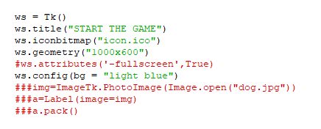
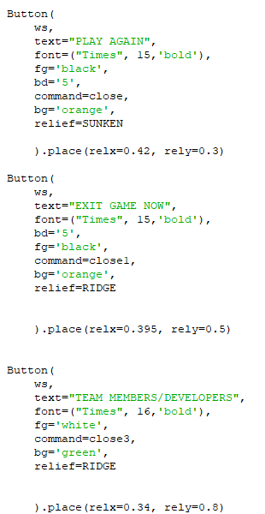
The Function startGame
Slide 4
If timeleft==0:
GUI development
Creating buttons

Slide 16
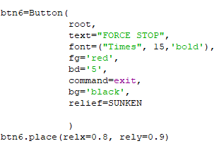
The Function startGame
Slide 5
Last button

Slide 18
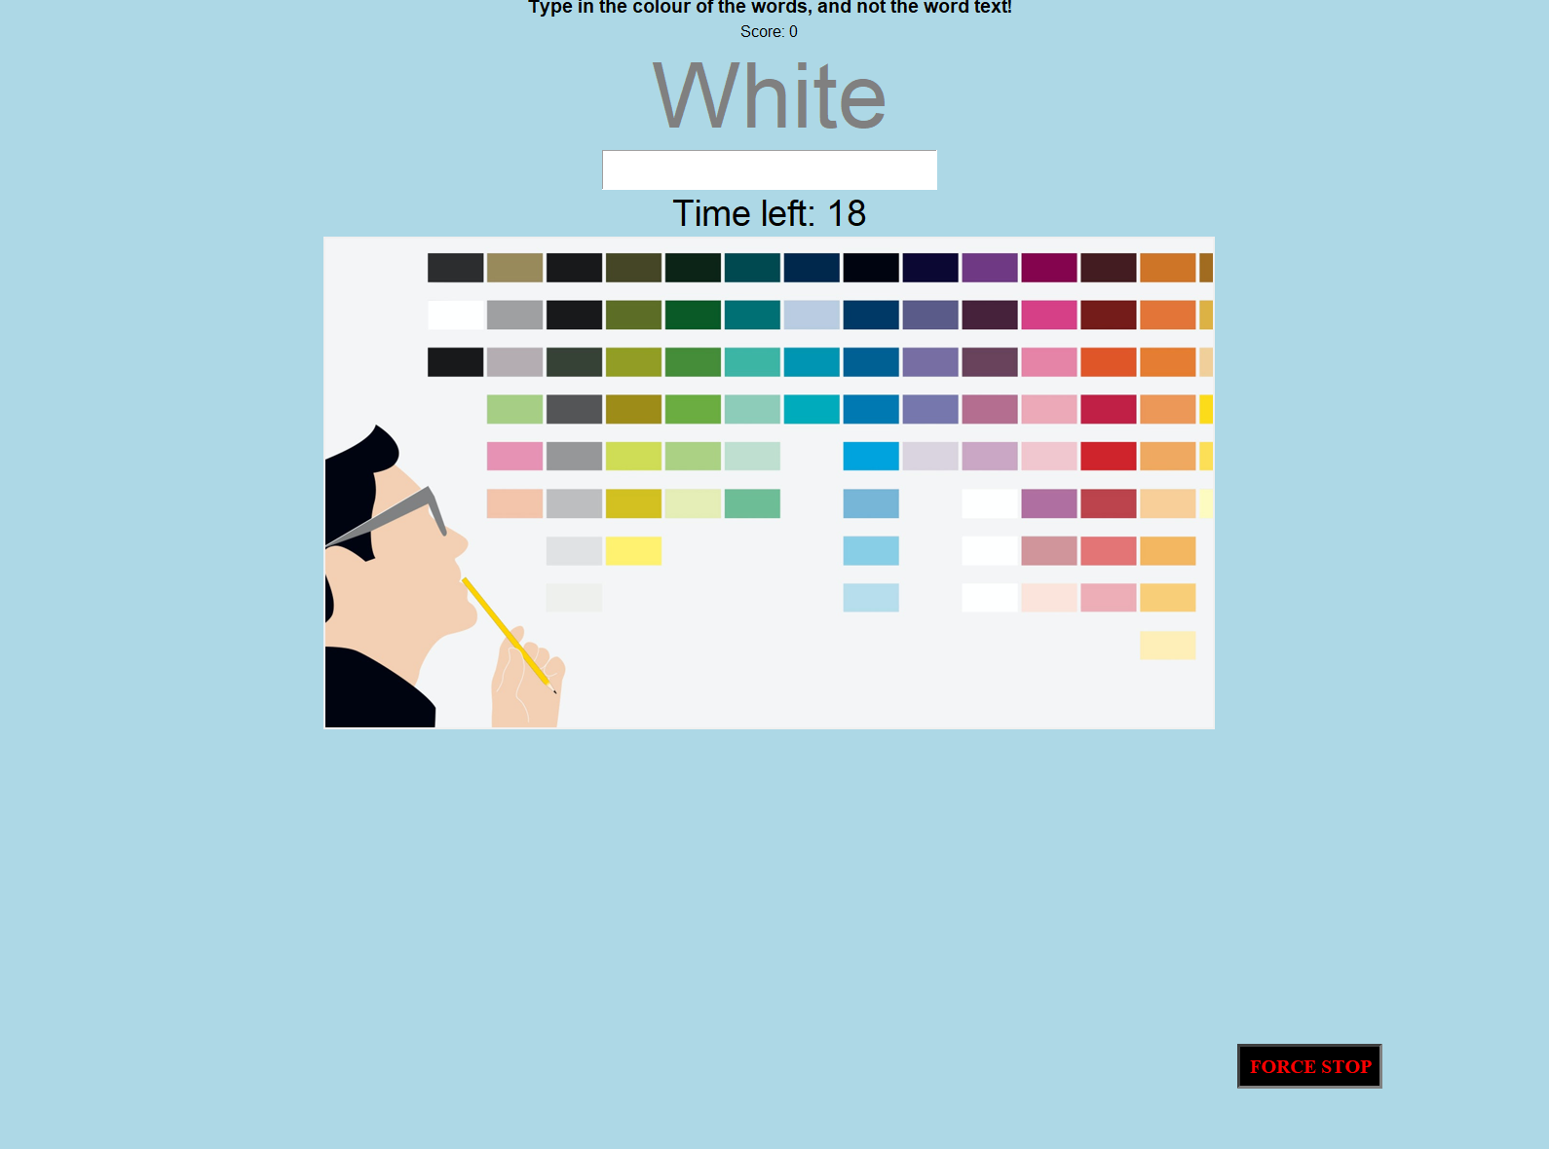
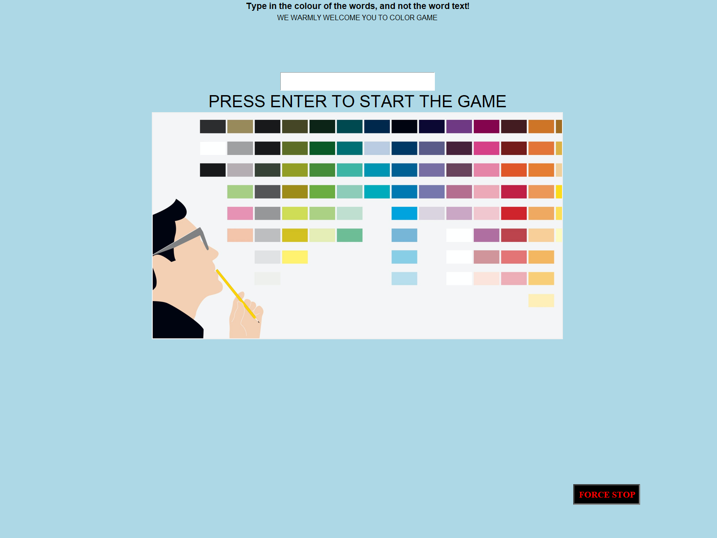
The Final Result
This will be the output after the file COLORS2 is executed.
The countdown would start as soon as the enter key is pressed

Slide 20
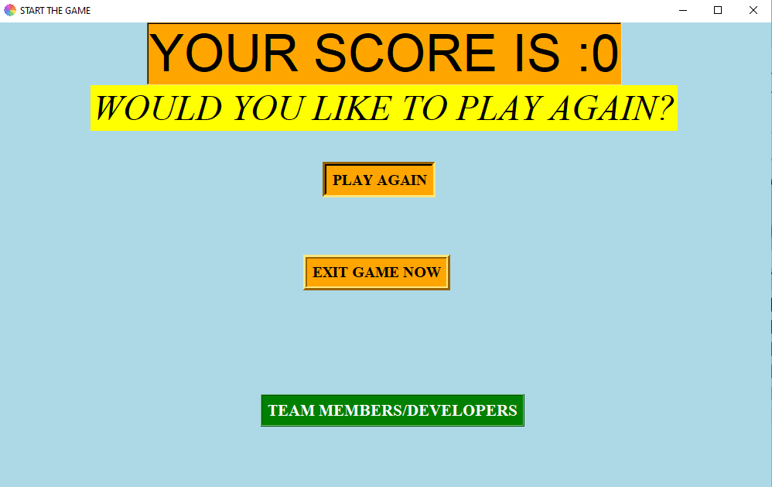
The Final Result
This will be the output after the file COLORS2 is executed.
If the time left becomes equal to zero, following GUI will be displayed

Slide 21
The same file COLORS2 would be executed to start the game again behind the play again button.

Slide 22
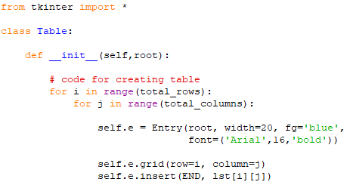
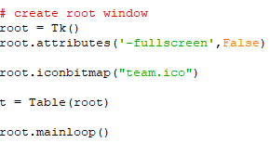
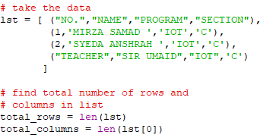
File COLORS4
Slide 1
The following code will display the
team members name in a tabular Form.
Importing tkinter module
Using Class for
creating table
Creating the GUI to display the table
Creating list
&
finding no. of
rows and columns

Slide 23
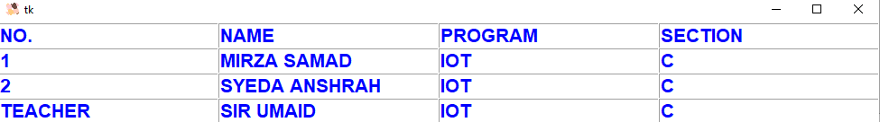
File COLORS4
Slide 2
The following will be the output after executing this file

Slide 24
Thank You.

